Slide 1
Problem
The social and financial impact of the Coronavirus
Your Customers Expect (3):
Focus on care and concern
Reach out with support, not marketing
50% say they have increased stress and worry (1)
5.2% decrease in the global economy this year (2)
1. Source: https://philanthropyu.org/infographic-covid-19s-effect-on-social-impact-perspectives-from-the-ground/
2 https://www.worldbank.org/en/news/press-release/2020/06/08/covid-19-to-plunge-global-economy-into-worst-recession-since-world-war-ii
3 https://www.mckinsey.com/business-functions/marketing-and-sales/our-insights/adapting-customer-experience-in-the-time-of-coronavirus

Slide 2
Solution
Video:
Interactive ai trained on techniques that are demonstrated effective at lowering stress and anxiety [show conversing with Lee]
The AI establishes a connection and gets permission to make customized suggestions [show making a recommendation and bringing up the calculator]
Linear optimizer is programmed to make creative suggestions for reaching personal goals with the minimum hardship [show adding a category, making selections and getting updates]
Improve the intelligence with access to transaction history and special-purpose knowledge bases [highlight the Ulster Bank button]

Slide 3
Solution
*Based on work with Naresh Vyas in the Applied AI Studio
Open core
Custom Extensions*
To better serve your customers
To reach out to anyone
Historical Transaction Data
Web App
Bank APIs
Flask
UI
AI
Custom Knowledge Base
Demographic Spending Patterns
Geographic Cost Patterns
iFrame
DialogFlow
Bot
Intents

Slide 4
Alternatives
Lee is the best way to make personal connection without restricting access
Professional Services
Personal
Lee
Personalized advice from experts
Use AI to make a connection and solve real problems
Restricted access
Open access
Calculators
Premium Tools
General Content
Premium Content
Provide limited access to premium insight
Make best practices generally available
impersonal

Slide 5
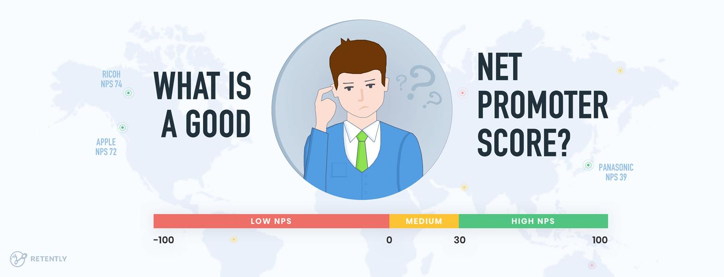
Business Model
Lee in creases your company’s net promoter score (NPS)
There is a strong link between organic growth and a company’s Net Promoter Score. (1)
In our beta test, the techniques used in Lee resulted in an 80 NPS
For financial services companies lifetime value of a promoter is 2.5 times higher than that of a detractor (2)
(1) https://www.netpromotersystem.com/about/how-net-promoter-score-relates-to-growth/
(2) https://customergauge.com/benchmarks/blog/financial-services-nps-benchmarks

Slide 6
Team
[Screenshot]
Demo: https://hello-lee.herokuapp.com/
Team DXC
[screenshot of the repo]
Open Source Code: https://github.com/dxc-technology/AI-Remote-Worker-Assistant
[with pictures]
Om Prakash Singh
Hitesh Kumar
Angeli Mae Trinidad
Hemanth Kum Arikatla
Jerry Overton

Slide 7
Closing
Next Steps: Roadmap to implementation
Hackathon Alpha Open Source release
Contributor days
Beta release
Open Release 1
API-specific Release 2
[Show as a roadmap or progression of steps]

